Slide 1
DG Interns Hub
Cybersecurity Internship – Week 1
Networking Fundamentals
Prepared by: Pooja G Shivakalimath

Slide 2
Week 1 Objectives
• Build a foundation in computer networking
• Learn the 7-layer OSI model
• Learn the 4-layer TCP/IP model
• Understand HTTP/HTTPS, FTP, DNS and DHCP
• Understand IP addressing and basic subnetting
• Practice ping, ipconfig and tracert
• Build and test a network in Cisco Packet Tracer

Slide 3
OSI Model – 7 Layers
7 – Application: network services for applications
6 – Presentation: formatting, encryption and compression
5 – Session: manages communication sessions
4 – Transport: end-to-end delivery; TCP/UDP
3 – Network: logical addressing and routing; IP
2 – Data Link: frames and MAC addressing; Ethernet
1 – Physical: transmission of bits over media

Slide 4
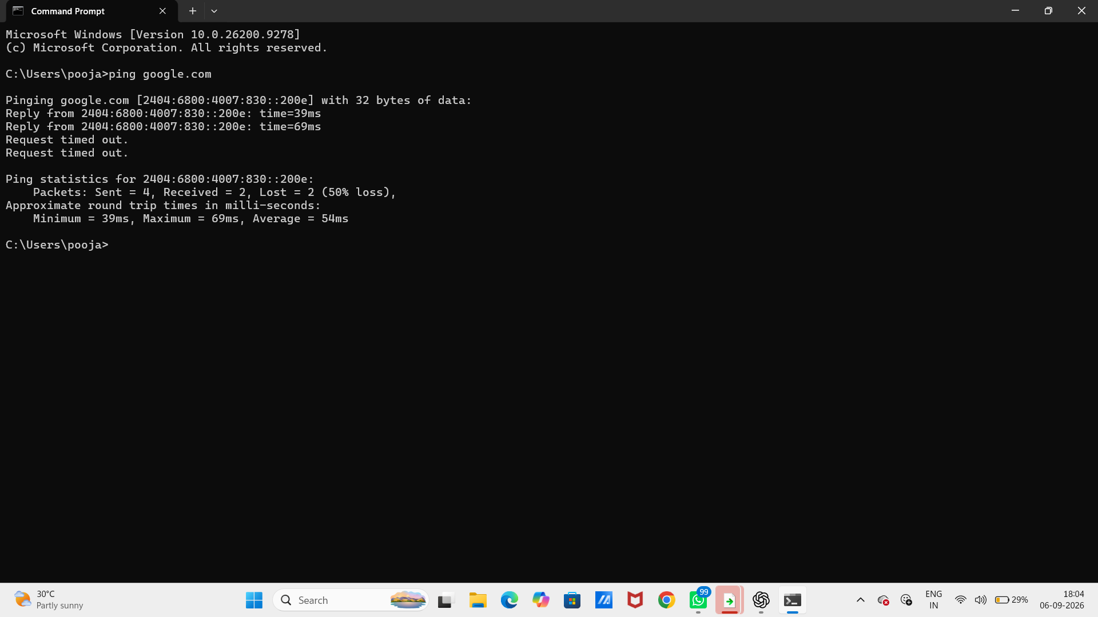
TCP/IP Model & OSI Comparison
TCP/IP has four commonly described layers:
• Application – HTTP, HTTPS, DNS, FTP, DHCP
• Transport – TCP and UDP
• Internet – IP and ICMP
• Network Access – Ethernet and Wi-Fi
OSI is a 7-layer reference model. TCP/IP is a practical model used by modern IP networks. TCP/IP Application broadly maps to OSI Application + Presentation + Session, while Network Access broadly maps to OSI Data Link + Physical.

Slide 5
Important Networking Protocols
HTTP / HTTPS – Web communication; HTTPS adds TLS protection.
FTP – File transfer between a client and server.
DNS – Converts domain names such as google.com into IP addresses.
DHCP – Automatically assigns IP configuration such as address, subnet mask and gateway.
Cybersecurity relevance: protocol knowledge helps analysts understand normal traffic and identify insecure or suspicious communication.

Slide 6
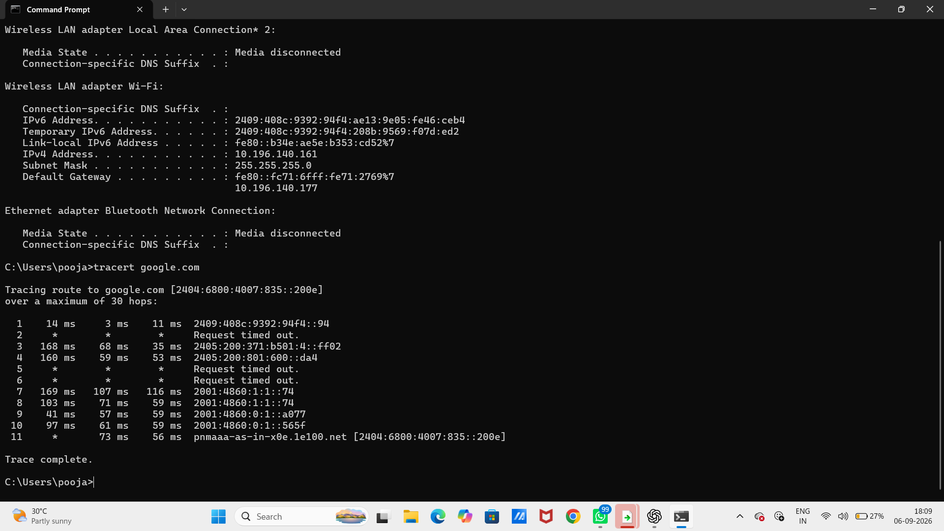
IP Addressing
IPv4 addresses are 32-bit logical addresses written as four decimal octets.
Private IPv4 ranges include:
• 10.0.0.0/8
• 172.16.0.0/12
• 192.168.0.0/16
Example used in Packet Tracer:
PC0: 192.168.1.10 / 255.255.255.0
Gateway: 192.168.1.1
A /24 subnet uses 24 bits for the network portion and 8 bits for hosts.

Slide 7
Network Commands – Practical
ping google.com – tests reachability and measures round-trip time.
ipconfig – displays local IP configuration, subnet mask and gateway.
tracert google.com – shows the route and intermediate hops toward a destination.
The practical screenshots captured real command output from Windows Command Prompt. Some timeouts were visible, demonstrating that real network paths can include non-responsive intermediate devices or packet loss.

Slide 8
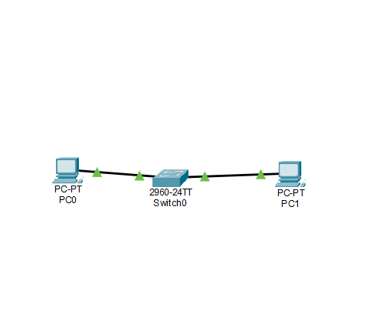
Cisco Packet Tracer – Practical
The Packet Tracer exercise included:
• PC devices and a 2960-24TT switch
• Copper Straight-Through connections
• IPv4 addressing
• Default gateway configuration
• Connectivity testing with ping
The assignment topology was extended to include a router with gateway address 192.168.1.1.

Slide 9
Results & Key Learnings
✓ Successfully built a basic switched network in Packet Tracer.
✓ Learned how IP addresses and subnet masks identify devices and networks.
✓ Tested communication using ping.
✓ Practiced Windows networking commands.
✓ Connected networking theory with a simulated practical environment.
Next learning direction: routing, subnetting in more depth, ports, packet analysis, network scanning and basic defensive security.

